Slide 1
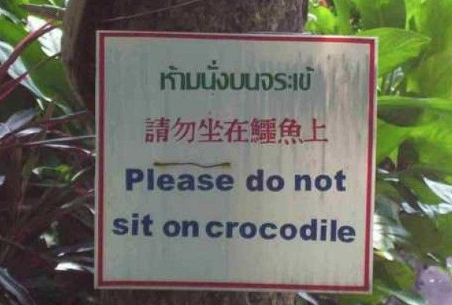
Using Common Sense in Computer Vision
Larry Zitnick
Microsoft Research
Devi Parikh
Virginia Tech

Slide 2
Common Sense
“Sound practical judgment derived from experience rather than study.”, Bing
“The basic level of practical knowledge and judgment that we all need to help us live in a reasonable and safe way”, Cambridge Dictonary

Slide 3
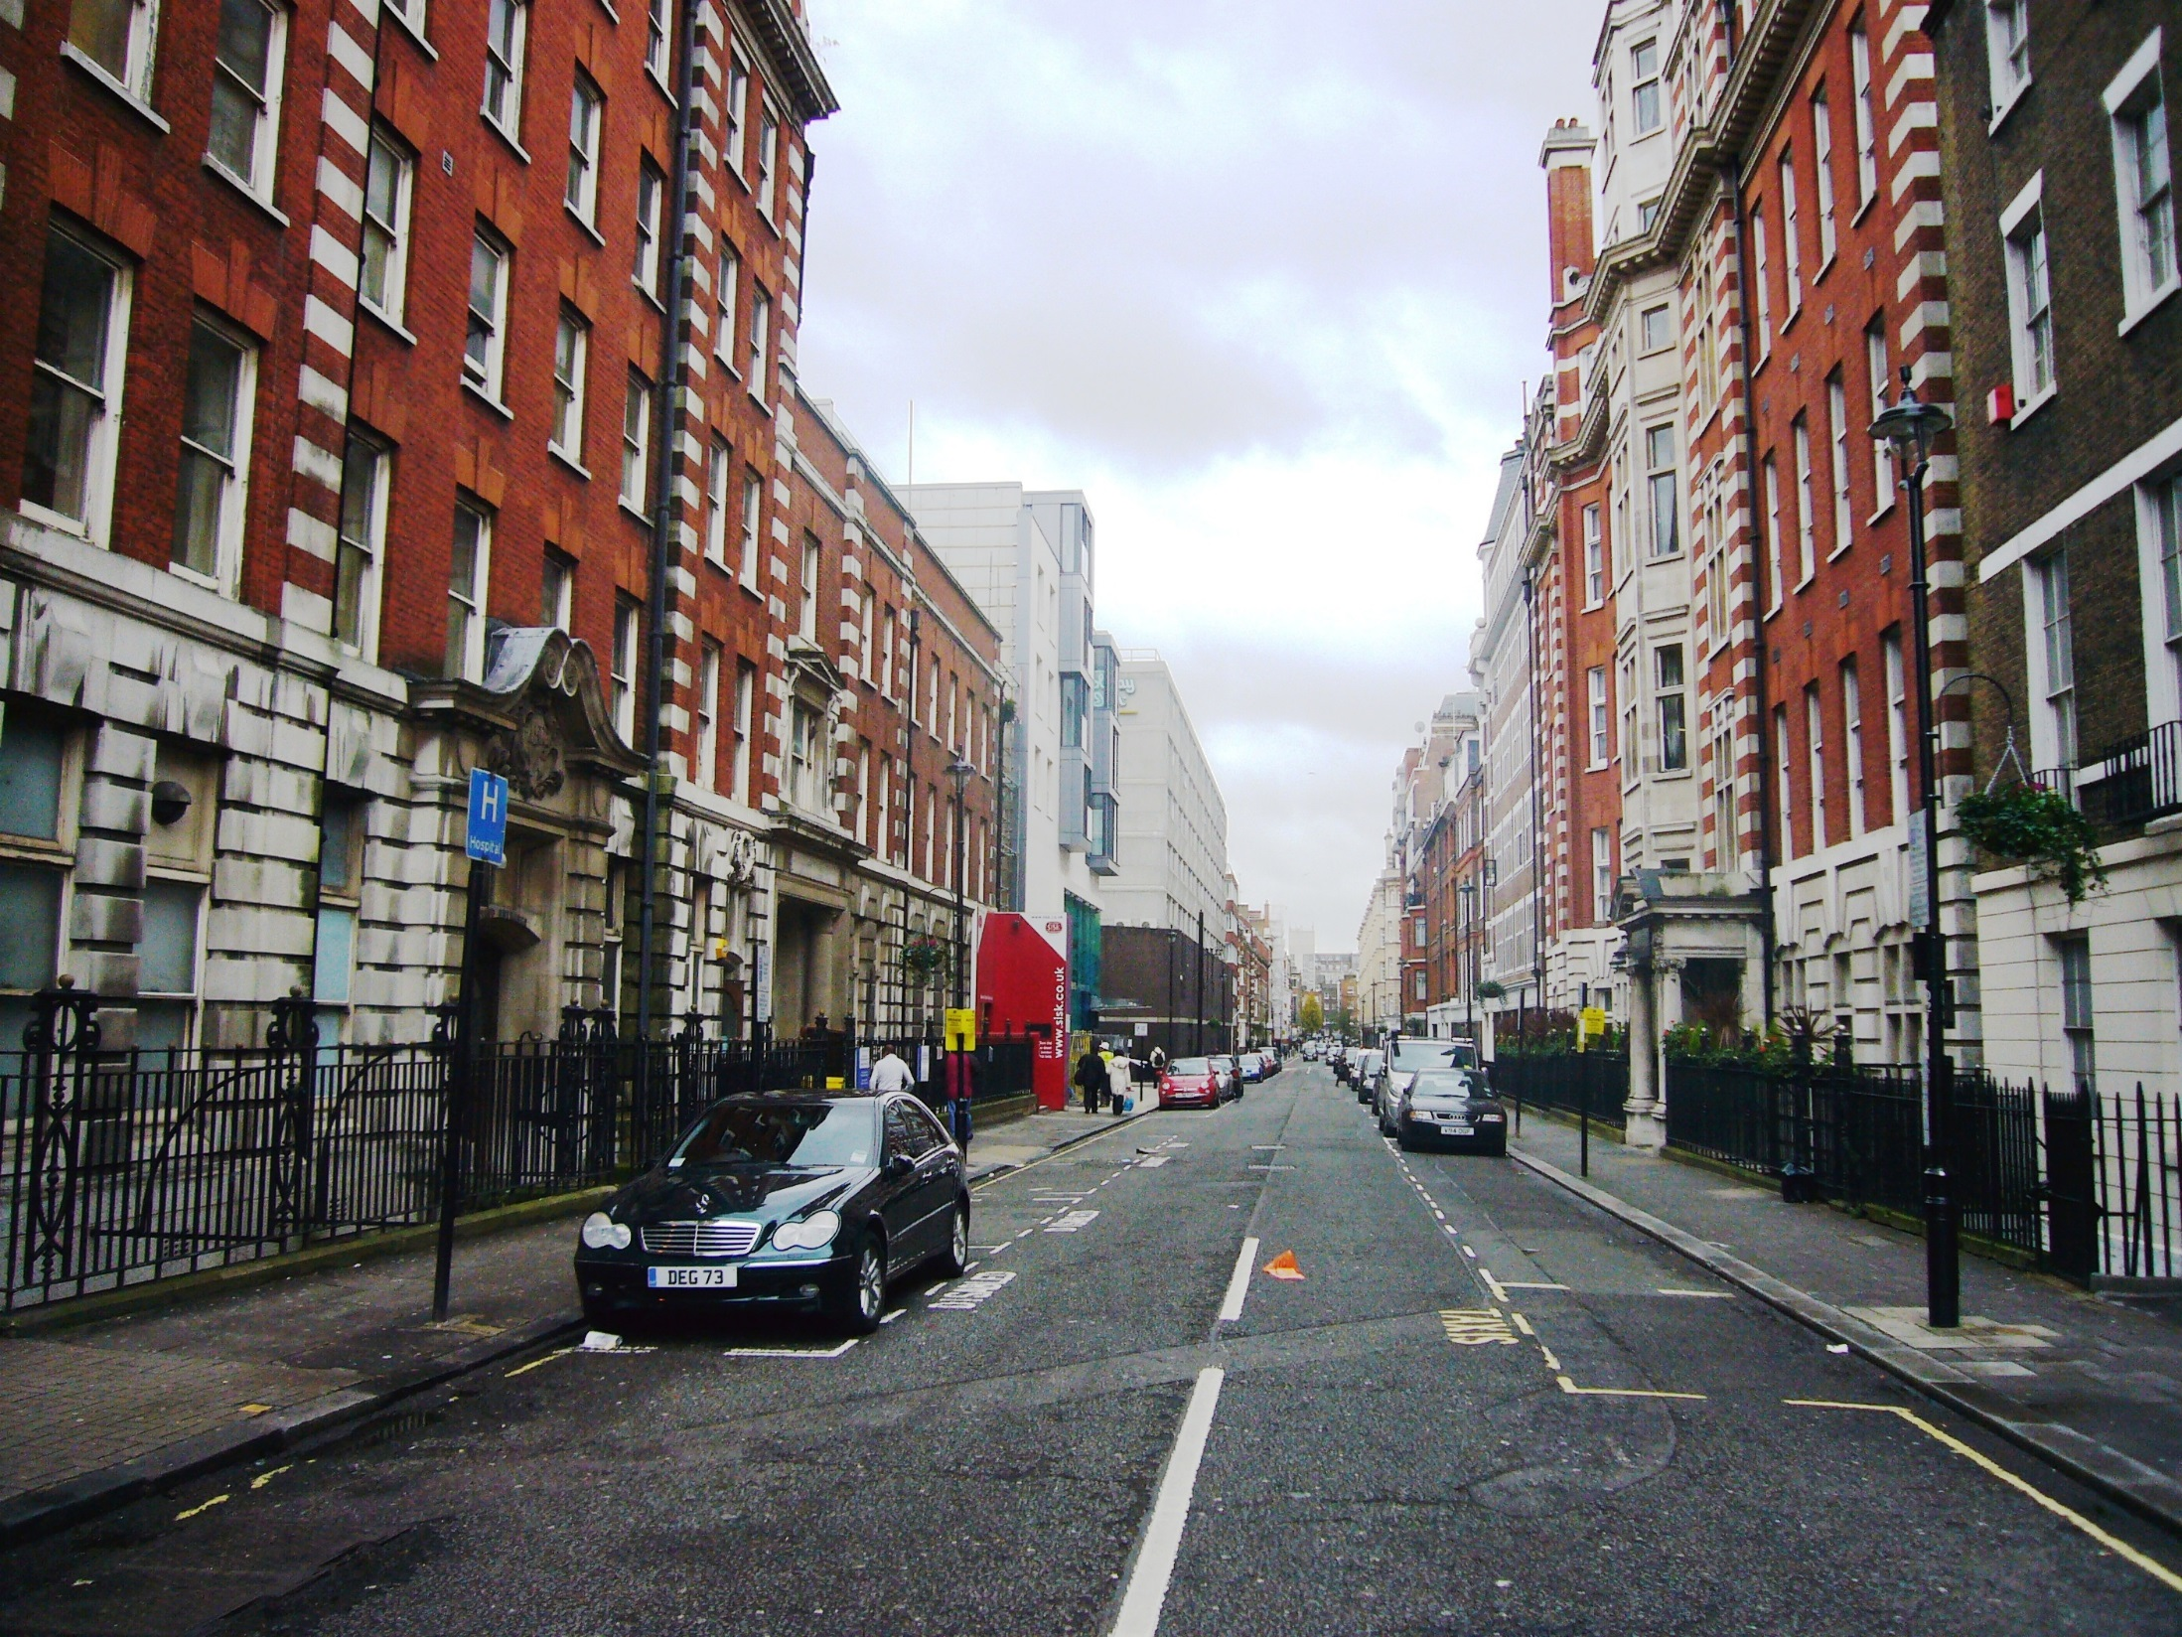
Context

Slide 4
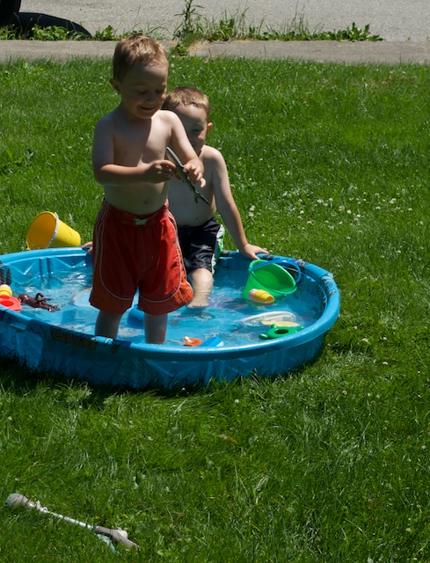
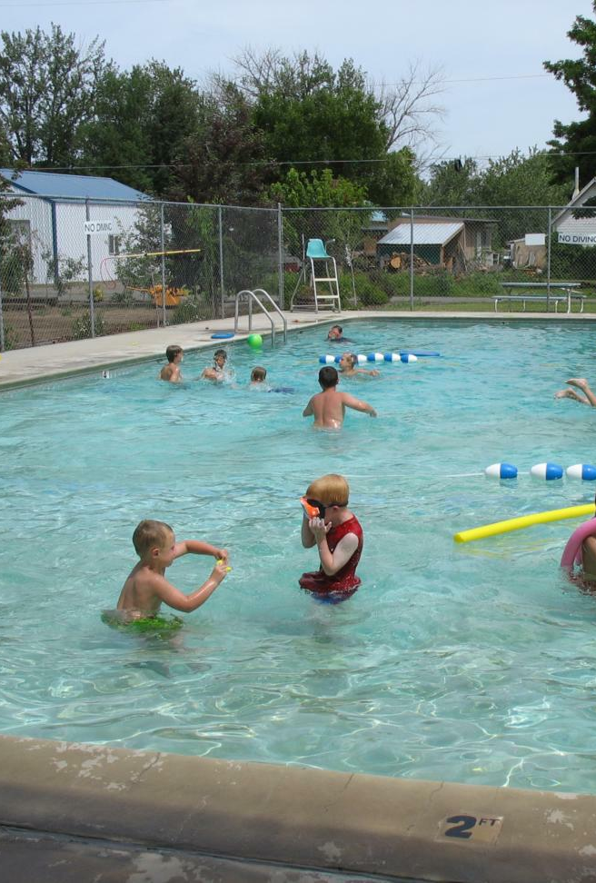
Attributes
Diving?

Slide 5
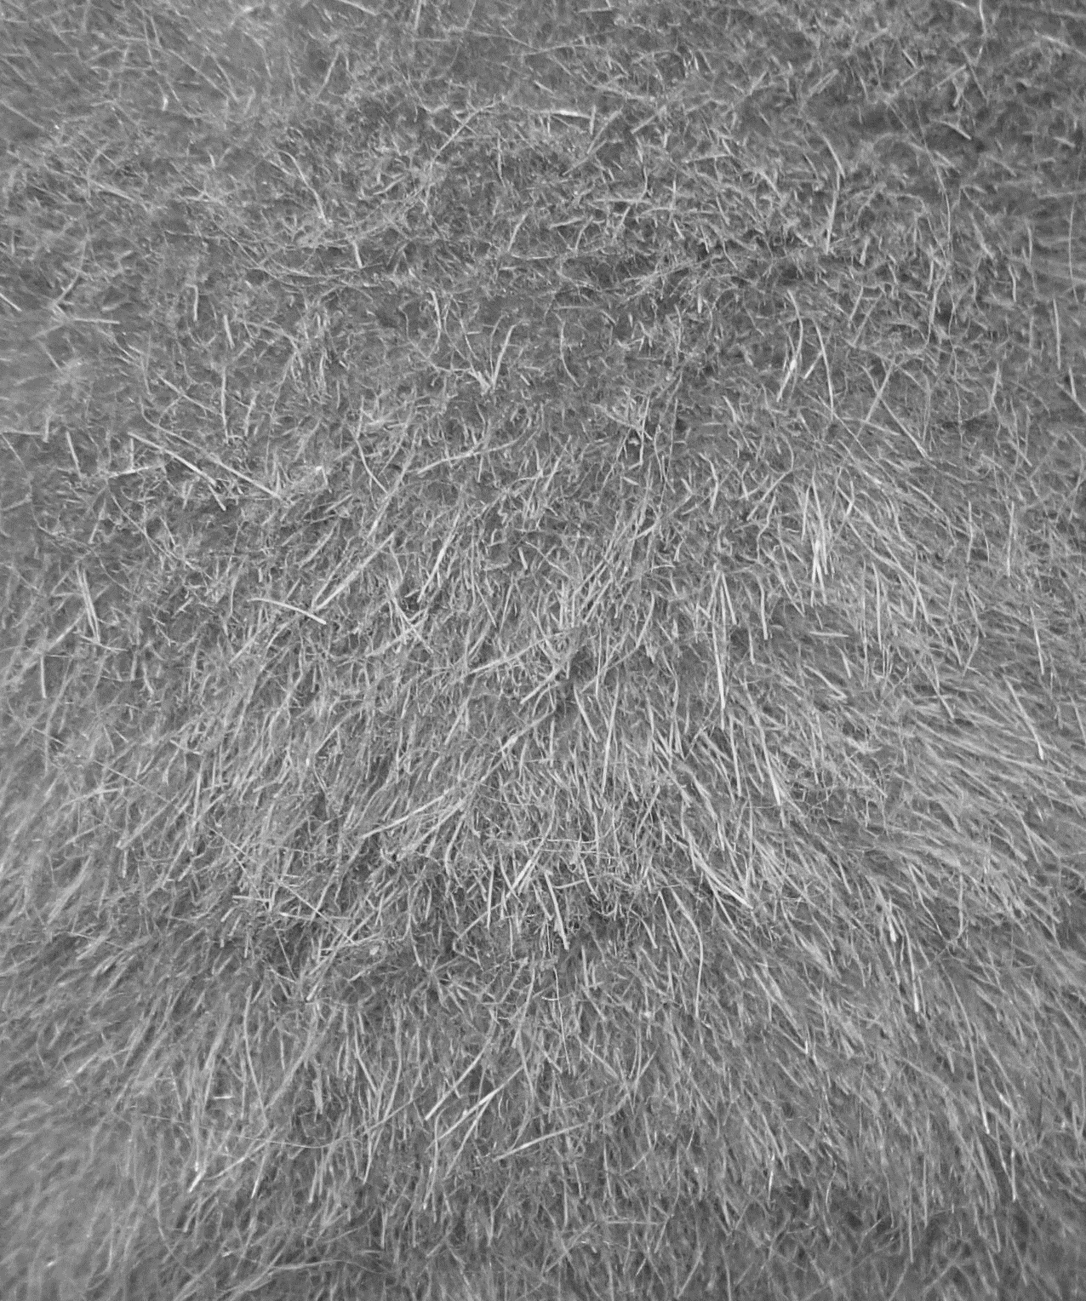
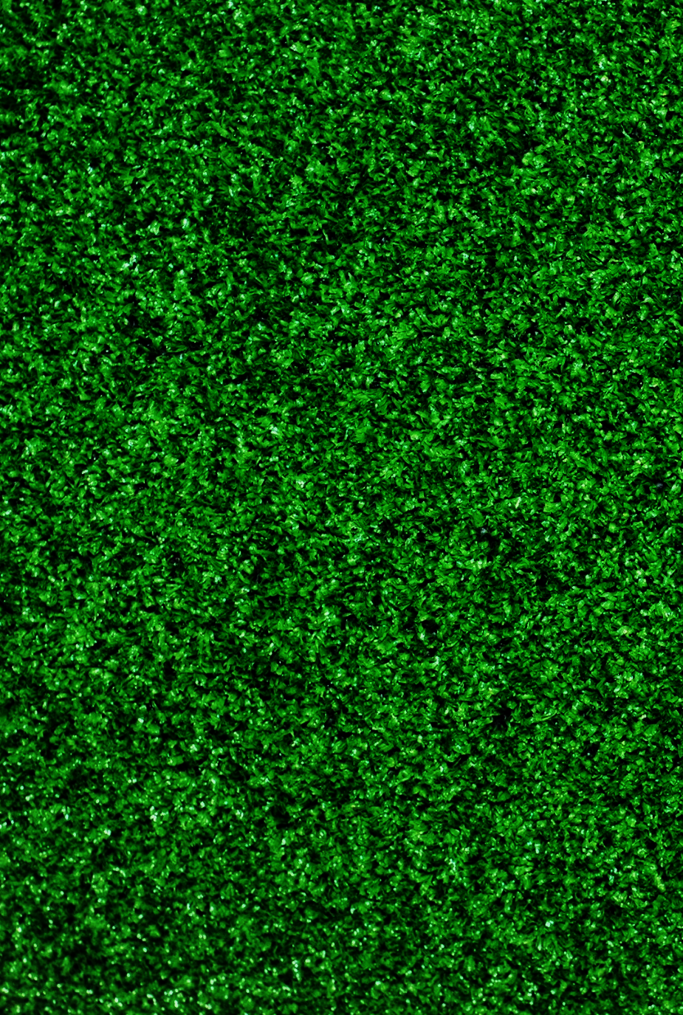
Rough
Furry

Slide 6
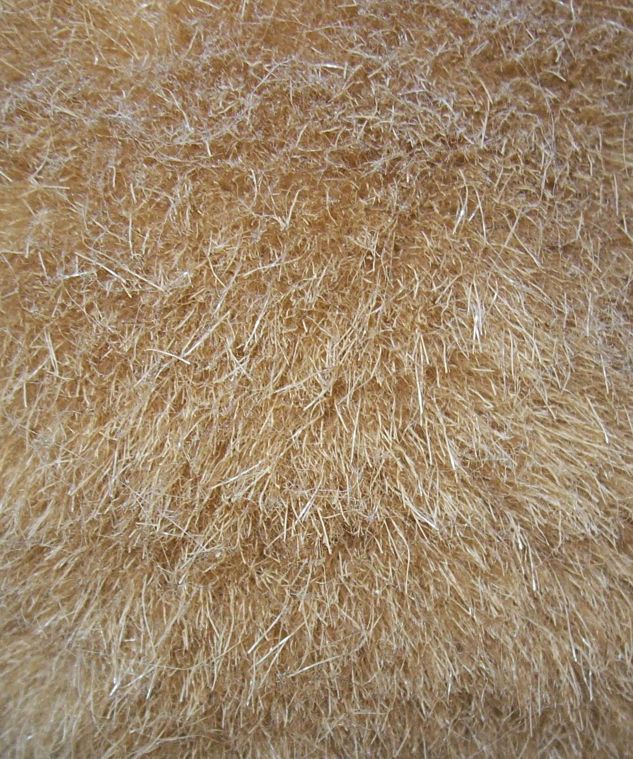
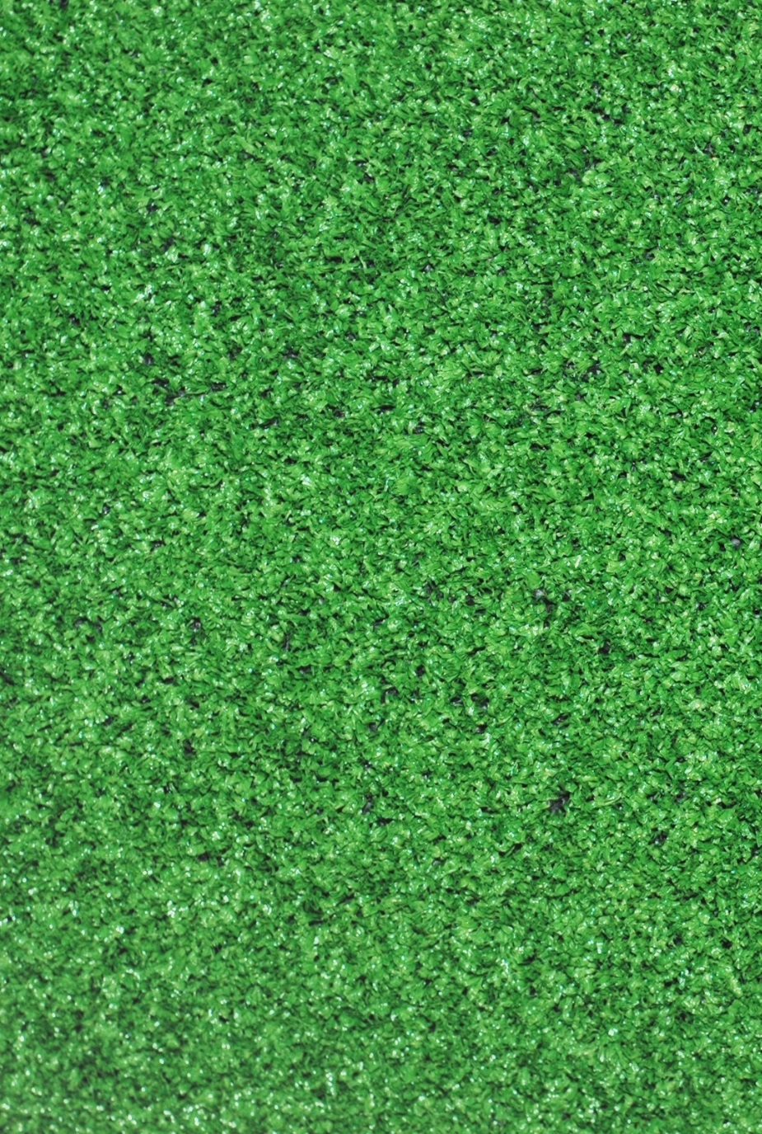
Furry
Rough

Slide 7
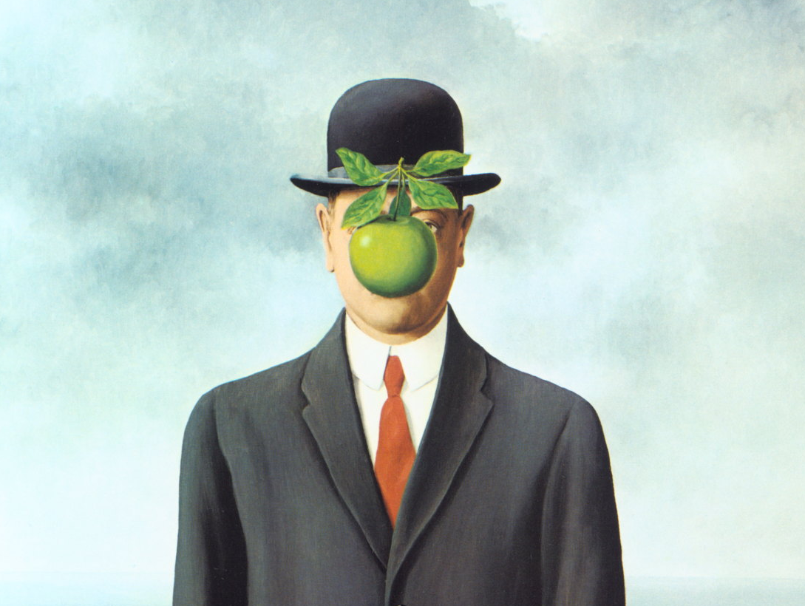
Son of Man, Magritte

Slide 8
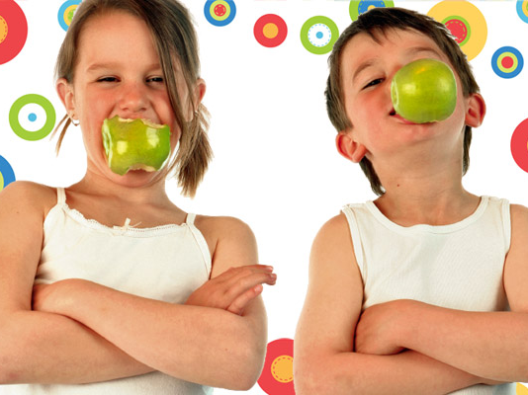

Slide 9
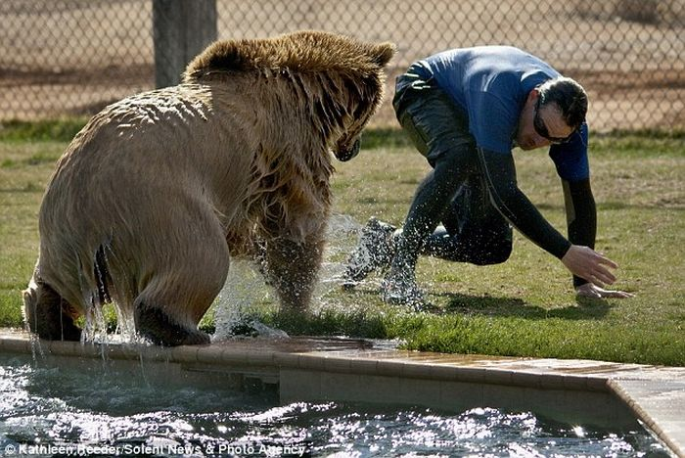
What is this man doing?

Slide 10
What is this man doing?

Slide 11
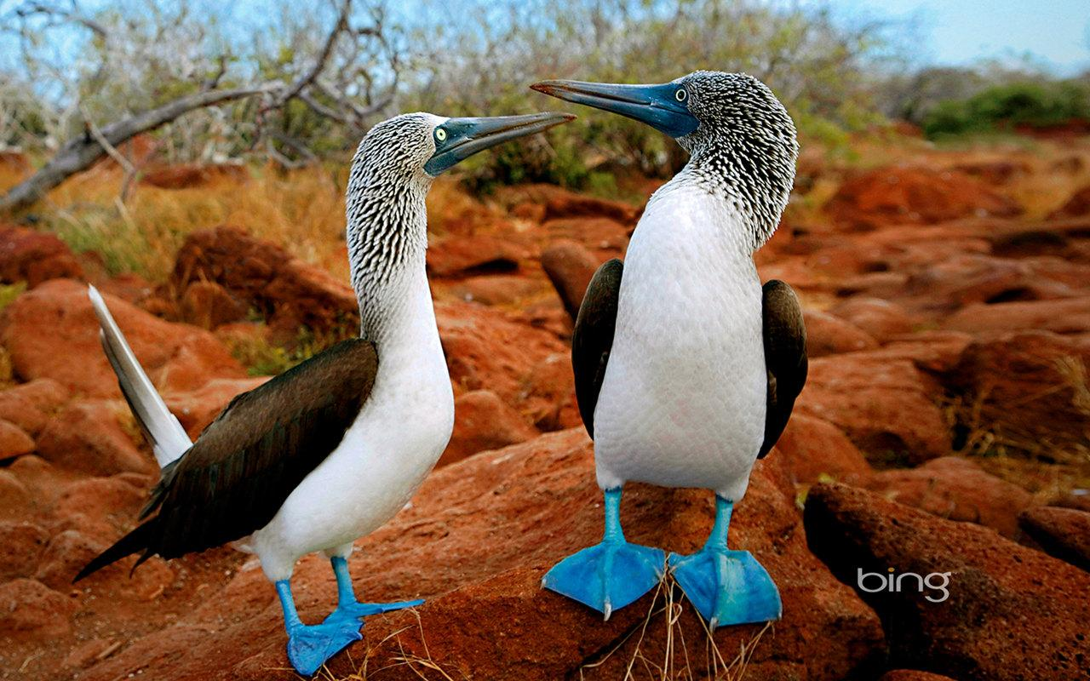
Two birds with funny blue feet.

Slide 12
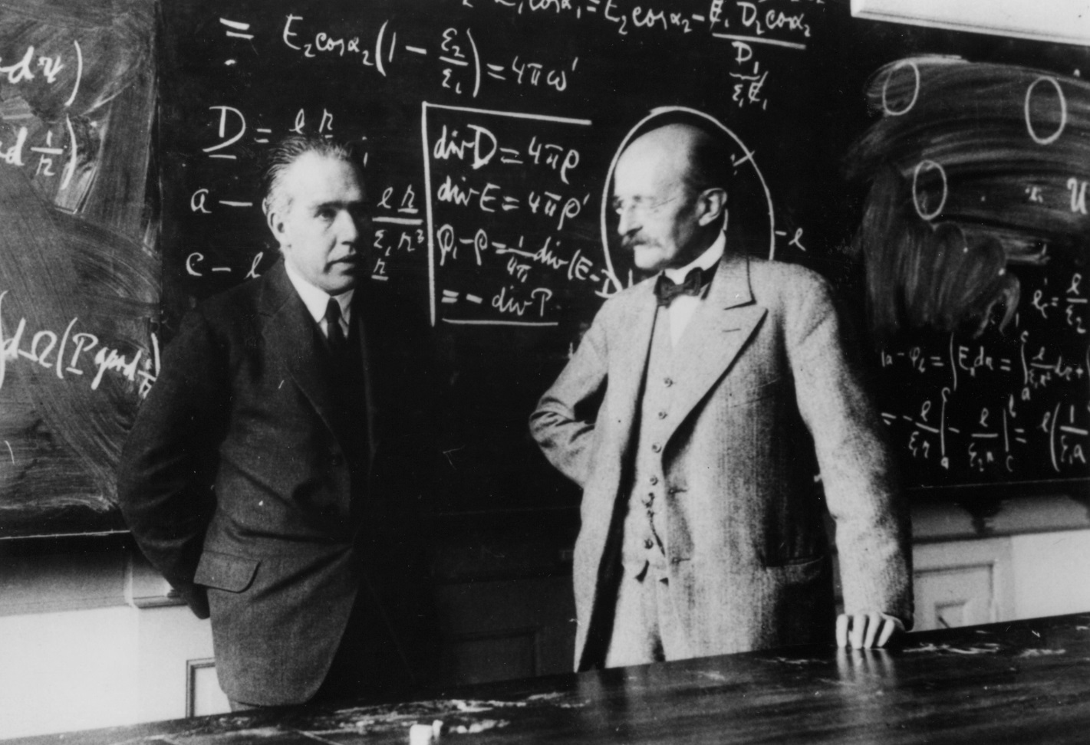
Two professors converse in front of a blackboard.

Slide 13

Semantics
CV
AI

Slide 14
Why is something so common so hard to find?

Slide 15
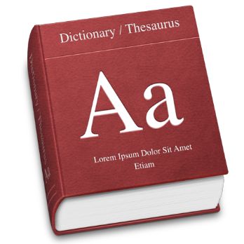
Does a bird fly?
Bird n. feathered animal.
Bird n. any of a class of warm-blooded vertebrates distinguished by having the body more or less completely covered with feathers and the forelimbs modified as wings.
Bird n. two-legged winged animal: a two-legged, warm-blooded animal with wings, a beak, and a body covered with feathers.

Slide 16
Does a bird fly?
Penguin n. seabird that cannot fly.
Penguin n. a large flightless seabird of the southern hemisphere

Slide 17

Does a bird fly?
Birds (class Aves or clade Avialae) are feathered, winged, bipedal, endothermic (warm-blooded), egg-laying, vertebrate animals. With around 10,000 living species, they are the most speciose class of tetrapod vertebrates. All present species belong to the subclass Neornithes, and inhabit ecosystems across the globe, from the Arctic to the Antarctic. Extant birds range in size from the 5 cm (2 in) Bee Hummingbird to the 2.75 m (9 ft) Ostrich. The fossil record indicates that birds emerged within theropod dinosaurs during the Jurassic period, around 150 million years ago. Paleontologists regard birds as the only clade of dinosaurs to have survived the Cretaceous–Paleogene extinction event 66 million years ago.
Modern birds are characterised by feathers, a beak with no teeth, the laying of hard-shelled eggs, a high metabolic rate, a four-chambered heart, and a lightweight but strong skeleton. All living species of birds have wings; the most recent species without wings was the moa, which is generally considered to have become extinct in the 16th century. Wings are evolved forelimbs, and most bird species can fly. Flightless birds include ratites, penguins, and a number of diverse endemic island species. Birds also have unique digestive and respiratory systems that are highly adapted for flight. Some birds, especially corvids and parrots, are among the most intelligent animal species; a number of bird species have been observed manufacturing and using tools, and many social species exhibit cultural transmission of knowledge across generations.

Slide 18

Web search

Slide 19


Cyc
Started in 1984, Doug Lenat
7 million assertions (common sense knowledge)
Both manually and automatically added
(#$isa #$Bird #$FlyingAnimal)

Slide 20
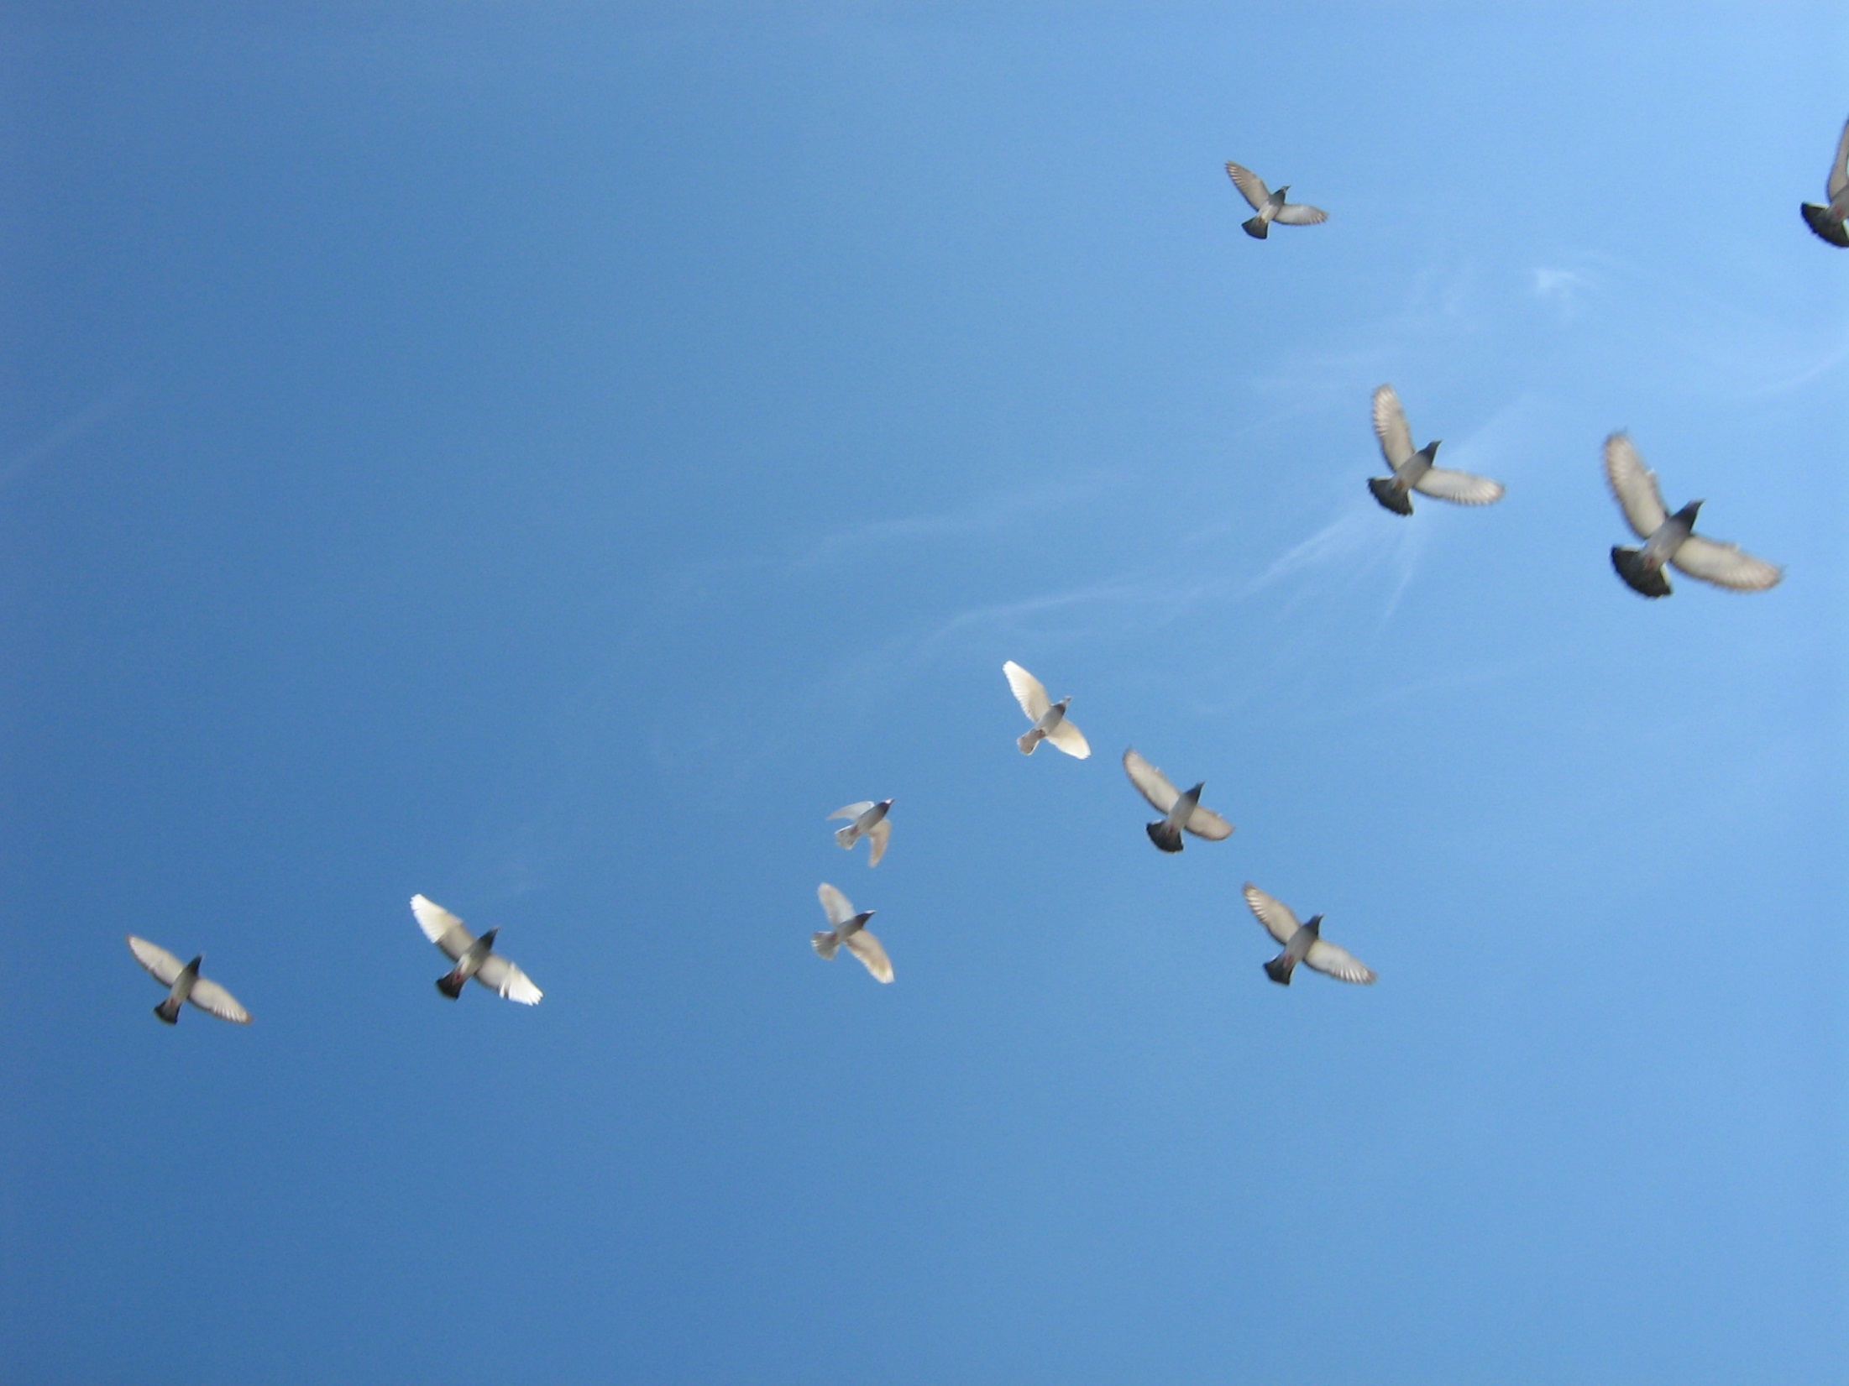
How do we know birds fly?

Slide 21
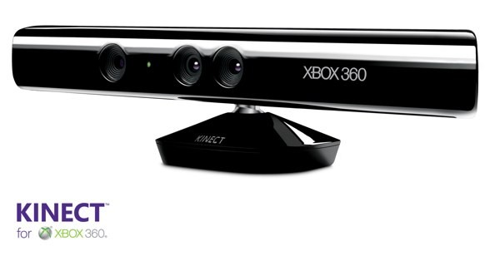
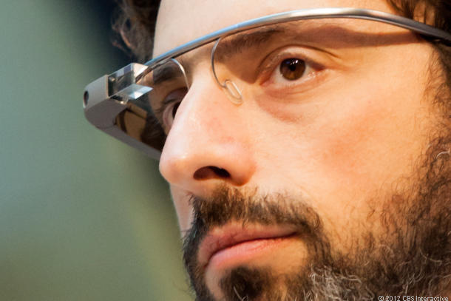
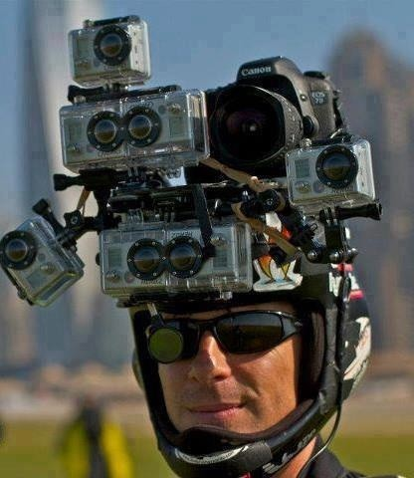
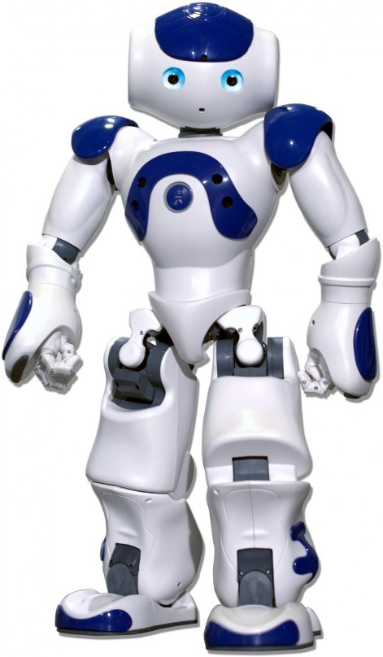

Slide 22
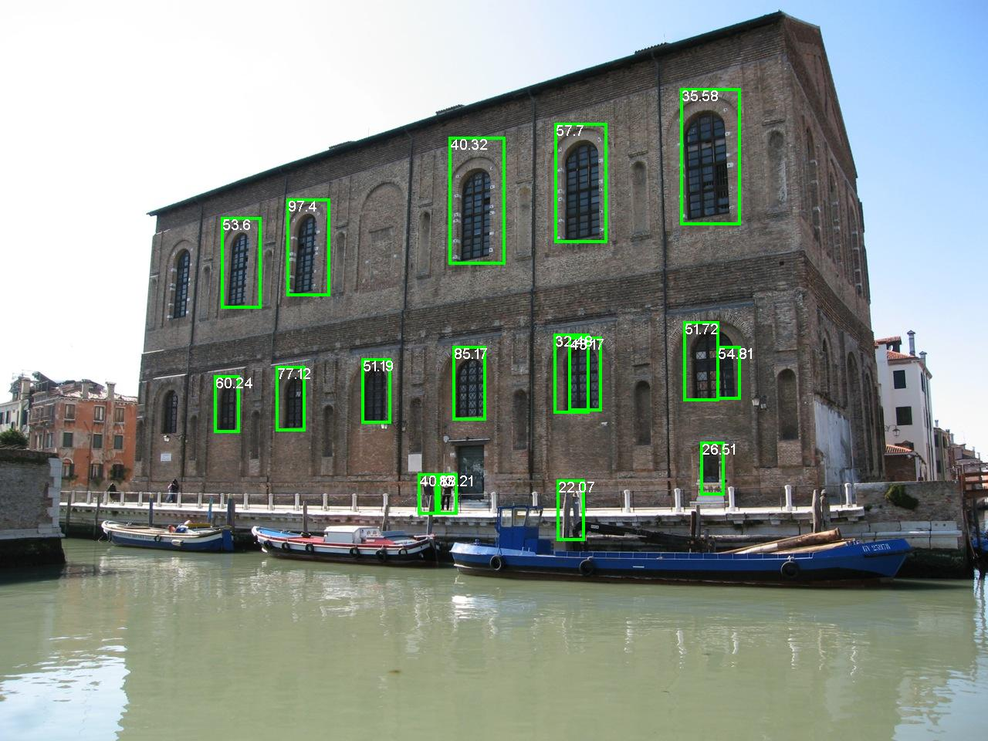
Person detections
Dollar et al., BMVC 2009

Slide 23
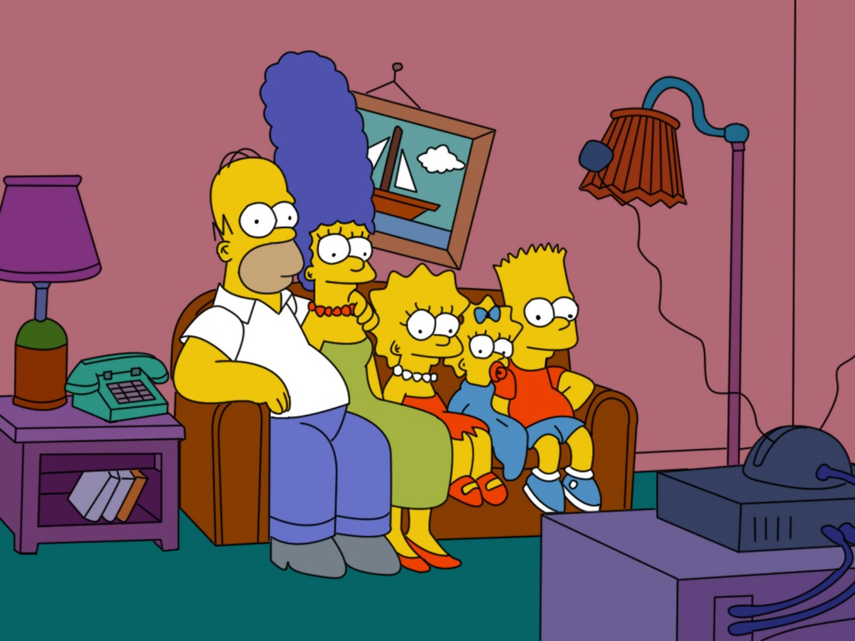

Slide 24
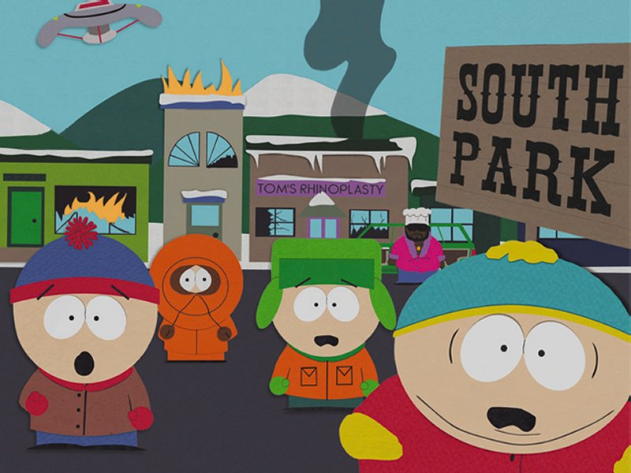

Slide 25
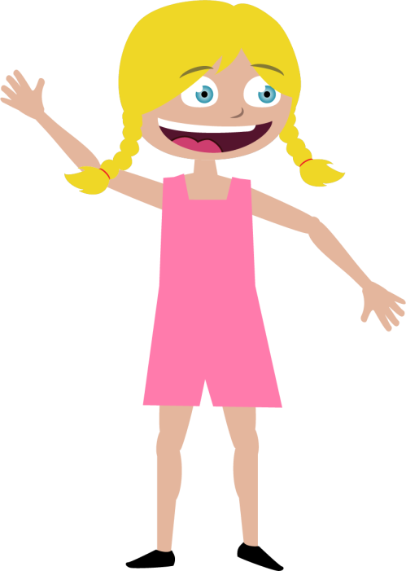

Jenny
Mike

Slide 26
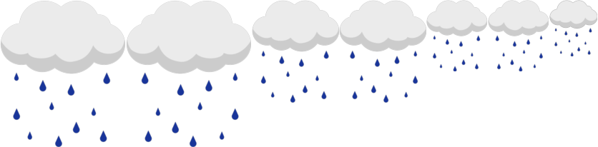


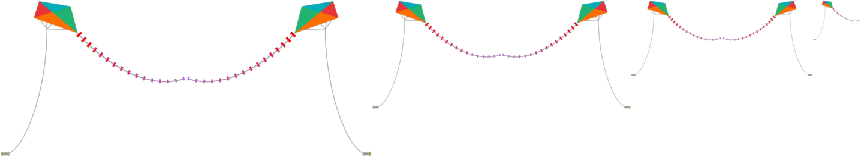
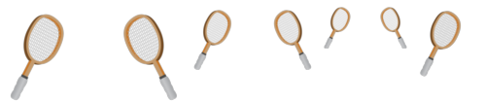
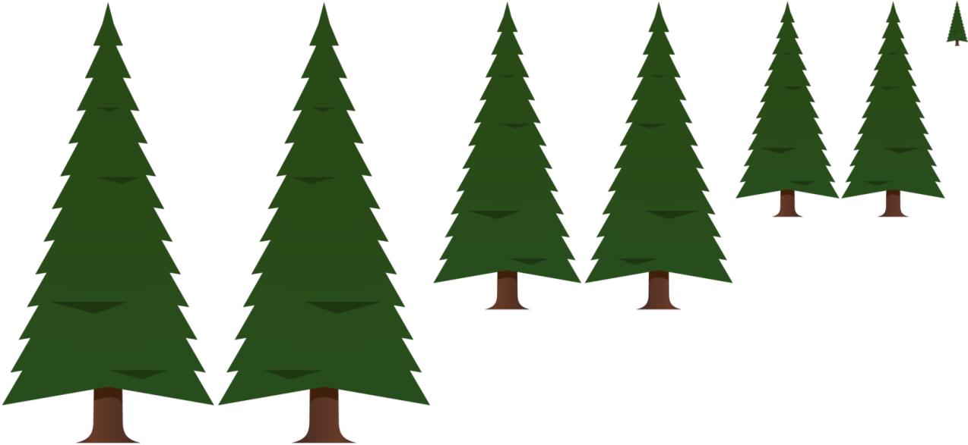
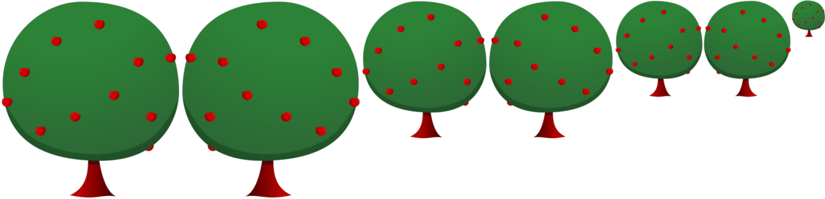
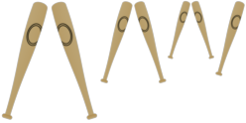
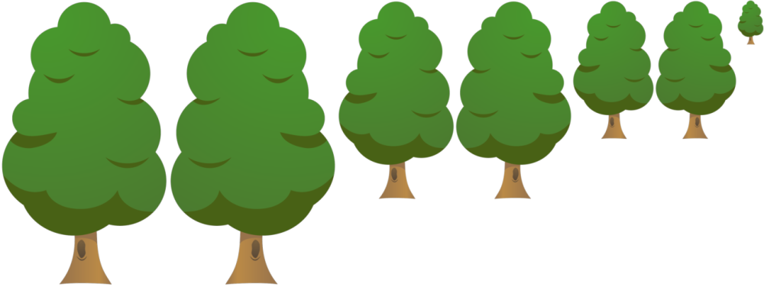





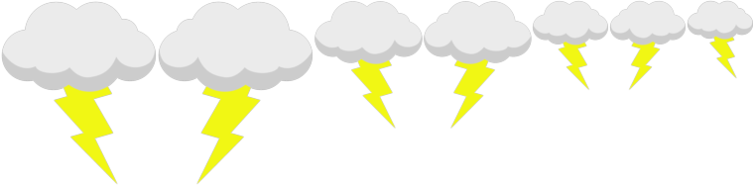




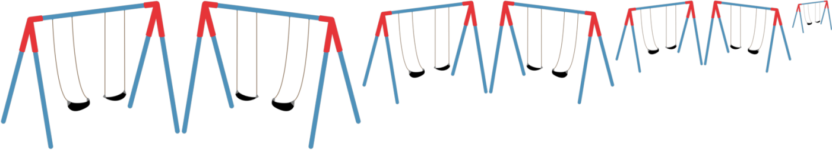


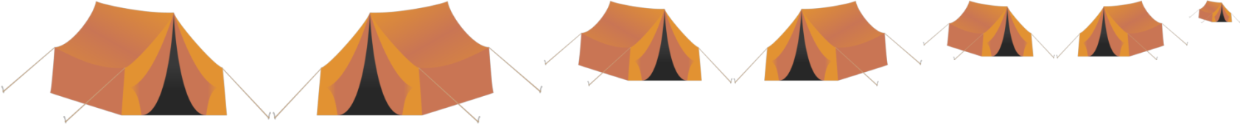

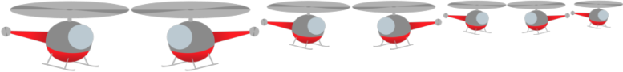


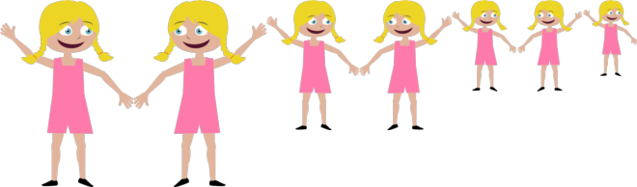
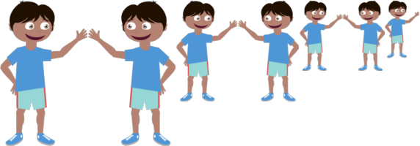


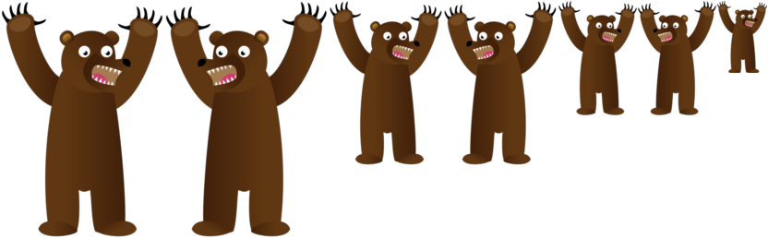


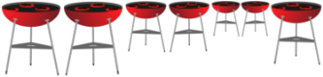






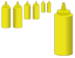

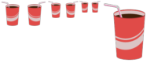





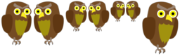
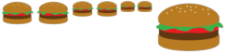
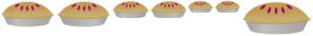

Slide 27



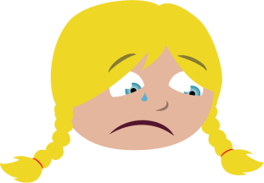







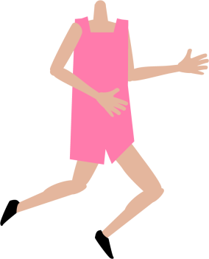
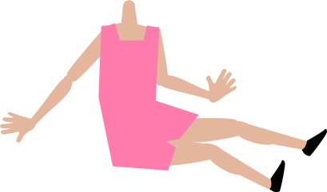
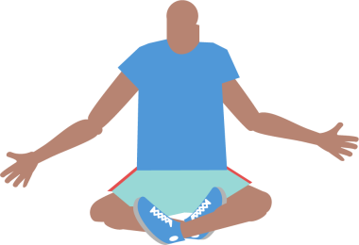
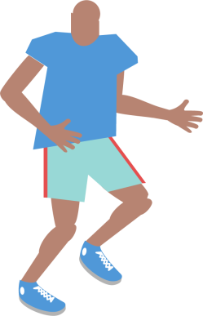
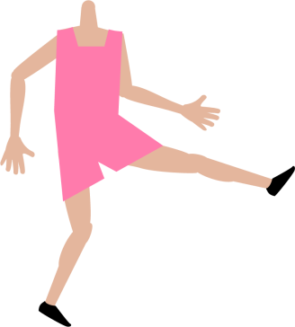
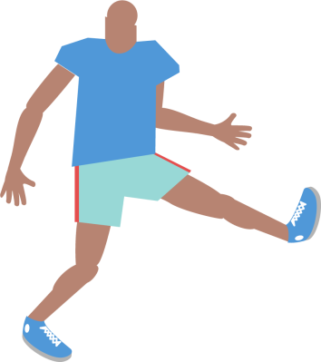








Slide 28

How do we generate scenes?

Slide 29

Visual features

Slide 30
Visual features
Cloud
Tree
Gaze
Smile
Gaze
Cat
Basketball
Person standing
Person sitting

Slide 31




Slide 32


Generating sentences
Jenny loves to play soccer but she is worried that Mike will kick the ball too hard.
Mike and Jenny play outside in the sandbox. Mike is afraid of an owl that is in the tree.

Slide 33
Previous work
Sentence generation
Farhadi et al., Every picture tells a story: Generating sentences from images. ECCV, 2010.
Ordonez et al., Im2text: Describing images using 1 million captioned photographs. NIPS, 2011.
Yang et al., Corpus-guided sentence generation of natural images. EMNLP, 2011.
Kulkarni et al., Baby talk: Understanding and generating simple image descriptions. CVPR, 2011.
Kuznetsova et al., Collective Generation of Natural Image Descriptions. ACL, 2012.
Gupta et al., Choosing Linguistics over Vision to Describe Images. AAAI, 2012.
Mitchell et al., Midge: Generating Image Descriptions From Computer Vision Detections. EACL, 2012.
Nouns
Spain and Perona, Measuring and predicting object importance. IJCV 2011.
Hwang and Grauman, Learning the relative importance of objects… IJCV, 2011.
Adjectives, prepositions
Gupta and Davis, Beyond nouns …, ECCV, 2008.
Farhadi et al., Describing objects by their attributes. CVPR, 2009.
Berg et al., Automatic attribute discovery and characterization from noisy web data. ECCV 2010.
Parikh and Grauman. Relative attributes. ICCV 2011.
Verbs
Yao and Fei-Fei, Modeling mutual context … in human-object interaction activities. CVPR 2010.
Sadeghi and Farhadi, Recognition using visual phrases. CVPR 2011.

Slide 34








Generating data
“Jenny just threw the beach ball angrily at Mike while the dog watches them both.”

Slide 35

Mike fights off a bear by giving him a hotdog while jenny runs away.

Slide 36

It was raining in the park and a duck and a snake were trying to take shelter.

Slide 37






Jenny and Mike are both playing dangerously in the park.

Slide 38



Semantic importance of visual features
1,000 classes of semantically similar scenes:
Class 1
Class 2
Class 1,000
1,000 classes x 10 scenes per class = 10,000 scenes

Slide 39

Mutual information
Semantic classes
Visual
features
Words

Slide 40















Object occurrence
High
Low
Mutual Information
Mutual Information

Slide 41













run away from
chase
run towards
run to

Slide 42

Most visually informative words

Slide 43

Least visually informative words
today
home
me
something
attention
using
isn’t
doing
went
give
behind
before
during
onto
through
how
since
why
finally
almost

Slide 44
Most visually informative words
Nouns
Verbs
Prepositions
Adverbs
Jenny
Mike
bear
soccer
cat
dog
ball
owl
snake
sandbox
pizza
rain
baseball
football
hamburger
pie
kicking
playing
holding
drink
are
catch
eat
wearing
flying
sitting
play
scare
sit
on
in
with
by
from
about
to
of
for
at
toward
after
under
over
into
away
down
off
out
happily
angrily
also
up
around
there
not
next
near
too
where
even

Slide 45


Stories

Slide 46


Stories

Slide 47


Stories

Slide 48


Stories

Slide 49


Stories

Slide 50






Why is Jenny scared?

Slide 51
Why is Jenny scared?

Slide 52
Why is Jenny scared?

Slide 53


Fun?
After these gems, I am going back to Mike and Jenny. I might be only making $5 an hour, but at least I will have fun doing it.
WOW, these are insanely entertaining after 8 solid hours of turking.
I'm going to miss these HITs when they are gone. Completely no value to the hour, but so much fun.
That was fun, but I can't make any money on these, too much time spent arranging the scenes..haha.

Slide 54












Realism?

Slide 55



3D?

Slide 56

Relevant?

Slide 57




New approach to learning
“common sense” knowledge about our world.
Don’t wait for object recognition to be solved.
Dataset online.
Thanks!

Slide 58
The end

